Slide 1


WATCH CATALOGUE
Project by
Domain
18DCS007 - RUDRA BARAD
18DCS064 - ANJALI PATEL
5CSE1 – Batch A & Batch C
Virtual Reality
Augmented Reality
Supervisor
CS348
Software Group Project - III
Ms. Krishna Patel
Notes:
R

Slide 2
01
INTRODUCTION AND MOTIVATION
02
CURRENT SYSTEM & ENHANCEMENT
03
04
GANTT CHART
05
HARDWARE & SOFTWARE ENVIRONMENTS
FLOW CHART
06
IMPLEMENTATION SNAPSHOTS
07
LIMITATIONS & FUTURE SCOPE
08
CONCLUSION
Notes:
R

Slide 3
A Watch Catalogue App which works on principles of Augmented Reality
INTRODUCTION
It can be used to check different watches without physically wearing and trying them.
Notes:
R

Slide 4
MOTIVATION
AR provides an Interactive Experience of a Real World Environment.
It creates a realistic environment where objects that reside in the real world are enhanced by computer generated perceptual information.
So ultimately we can virtually try on things even before investing in it
Notes:
A

Slide 5
CURRENT SYSTEM
It only has photos of the watches, so the model cannot be tried
Lack of Touch and Feel of Merchandise in Online Shopping
ENHANCEMENTS
Real Shopping experience can be provided
We have improvised customer satisfaction so that they can examine the originality/quality of product
Notes:
A

Slide 6

HARDWARE SOFTWARE
HARDWARE
AND SOFTWARE ENVIRONMENT
WATCH
CATALOGUE
Laptop/computer with Core i5 8TH gen. Processor
2GB Hard Disk Storage
Unity Hub
Android (C#)
Vuforia Package
Notes:
A

Slide 7
GANTT CHART
Understanding the basics of Unity and getting started with Vuforia Framework
01
Installing and Setting up Unity and Vuforia
02
Notes:
R

Slide 8
A TIMELINE ALWAYS WORKS WELL
Creating an App having proper functionalities
04
Testing the project, improving its features and developing it as a furnished product
03
Notes:
R

Slide 9
POSSIBLE APPROACH

Slide 10
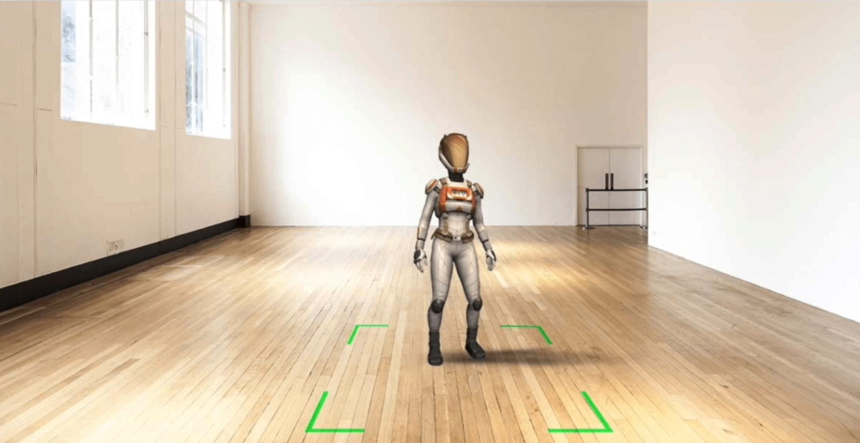
VUFORIA GROUND PLANE DETECTION
Notes:
A

Slide 11
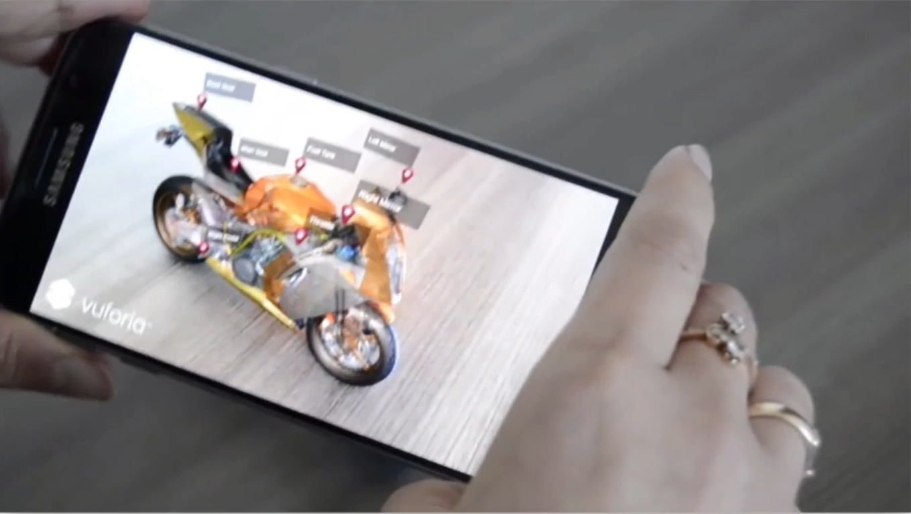
VUFORIA OBJECT TRACKING
Notes:
A

Slide 12
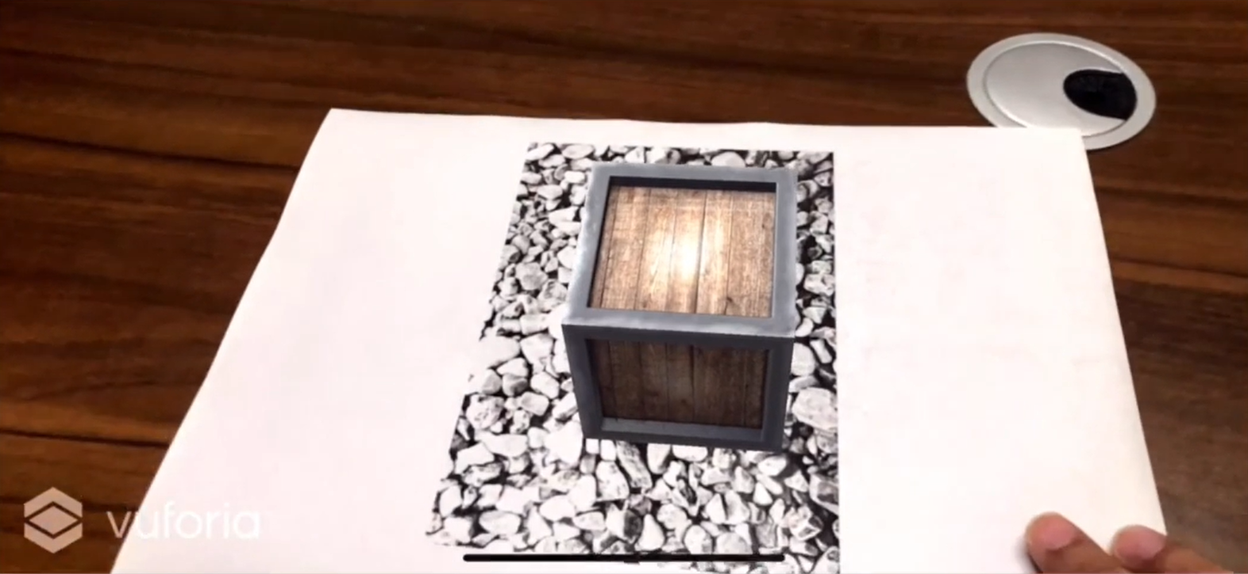
VUFORIA IMAGE TRACKING
Notes:
A

Slide 13
FLOW CHART

Slide 14
CREATING CORE FUNCTIONALITY
Select Target Image
Adding and Setting up Watch models in Unity
Dial
Band
Glass
Back
Buckle
Sewing
Adding Reflections
Adding Watch models to Image Target
Adding Occlusion
Notes:
A

Slide 15
CREATING APP UI & ADDING FUNCTIONALITY
Created Watch Options
Creating Watch Window
Name
Image
Price
Colour Palette
Adding Animations
C# Script to make the application Interactive
Watch Button
Colour Button
Close Button
Testing Functionality & Features of application
Notes:
R

Slide 16
IMPLEMENTATION SNAPSHOTS

Slide 17
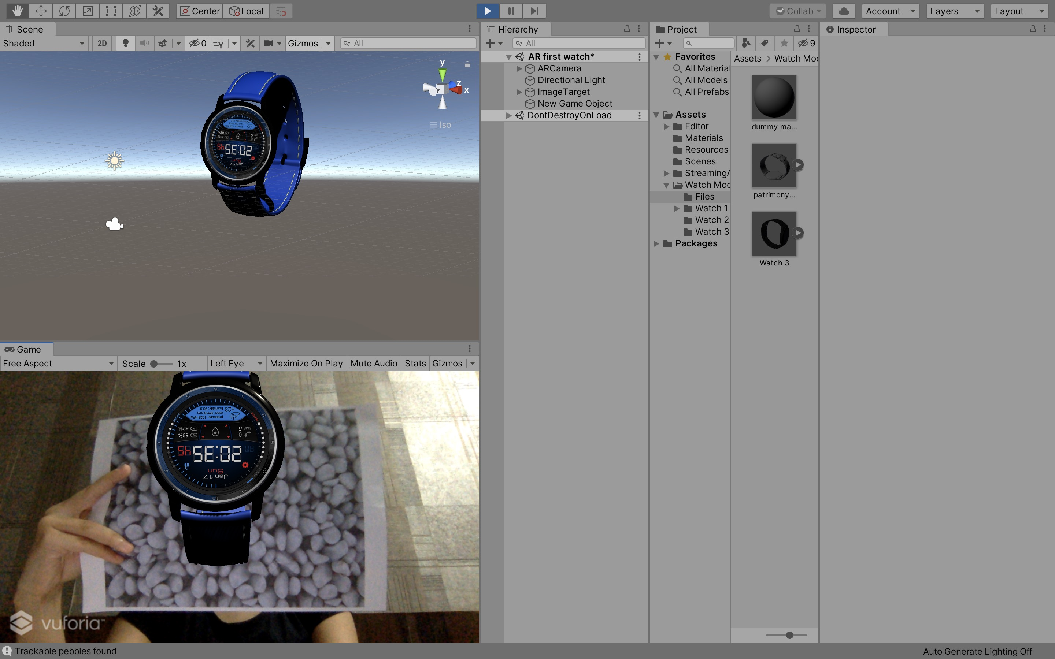
WATCH MODEL
Notes:
R

Slide 18
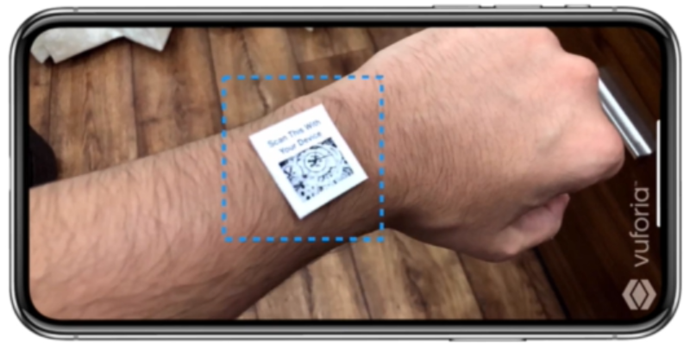
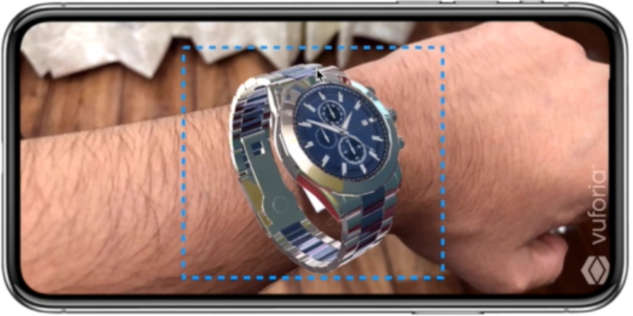
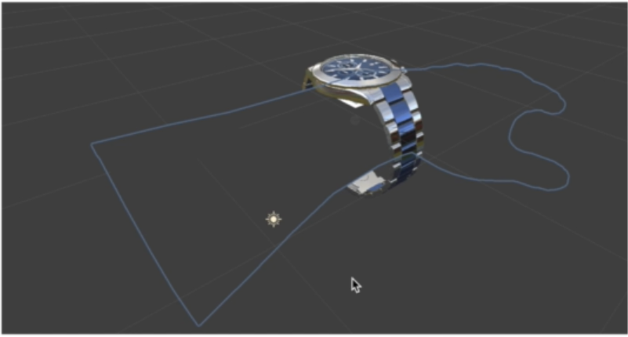
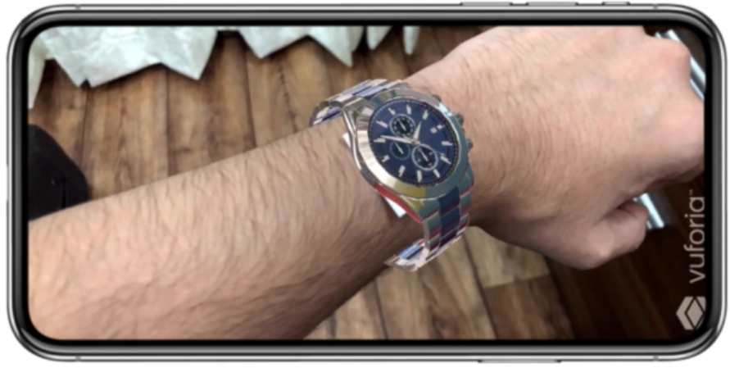
ADDING OCCLUSION
Notes:
R

Slide 19
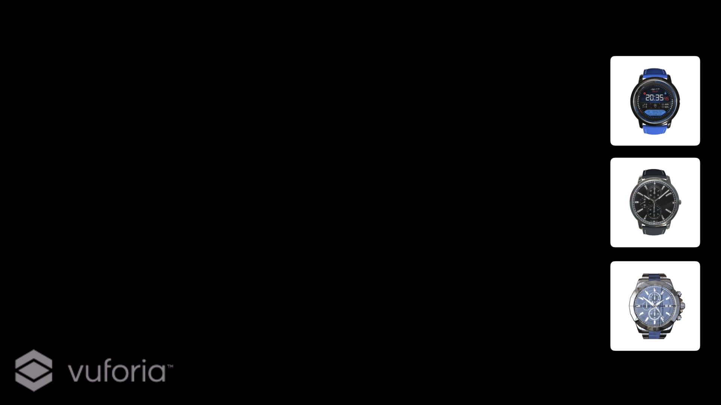
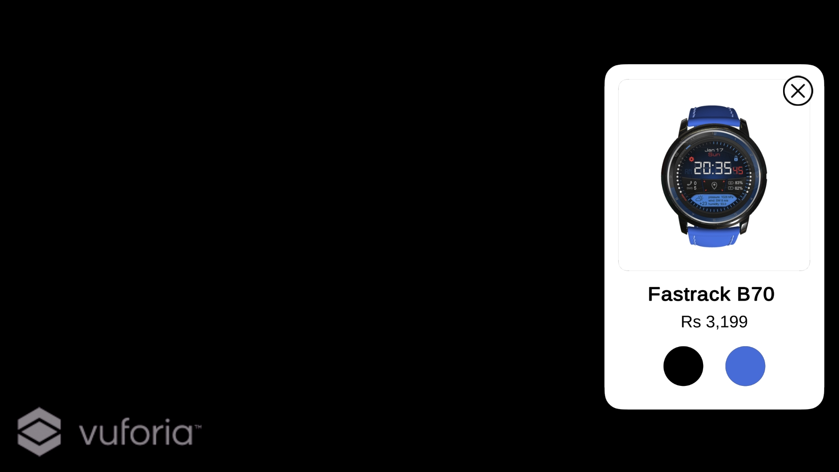
APP UI
Notes:
R

Slide 20
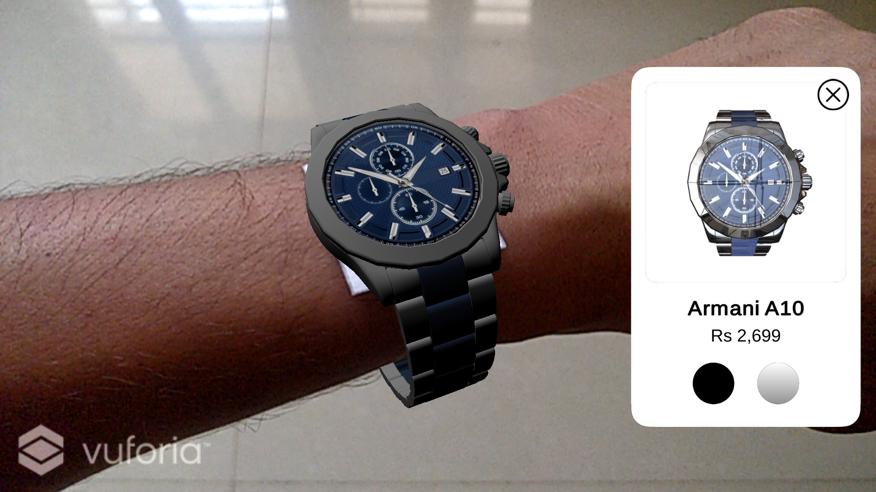
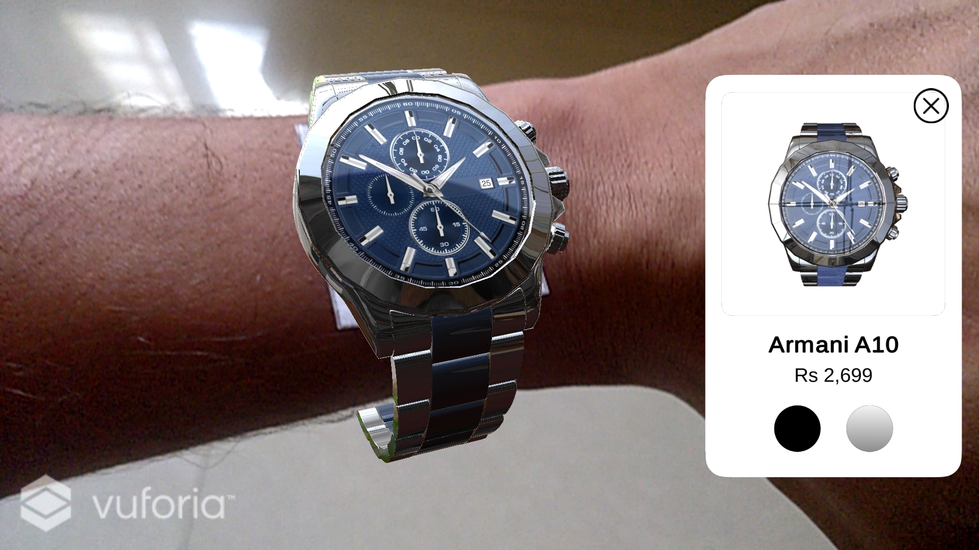
WITHOUT REFLECTION
WITH REFLECTION
Notes:
R

Slide 21
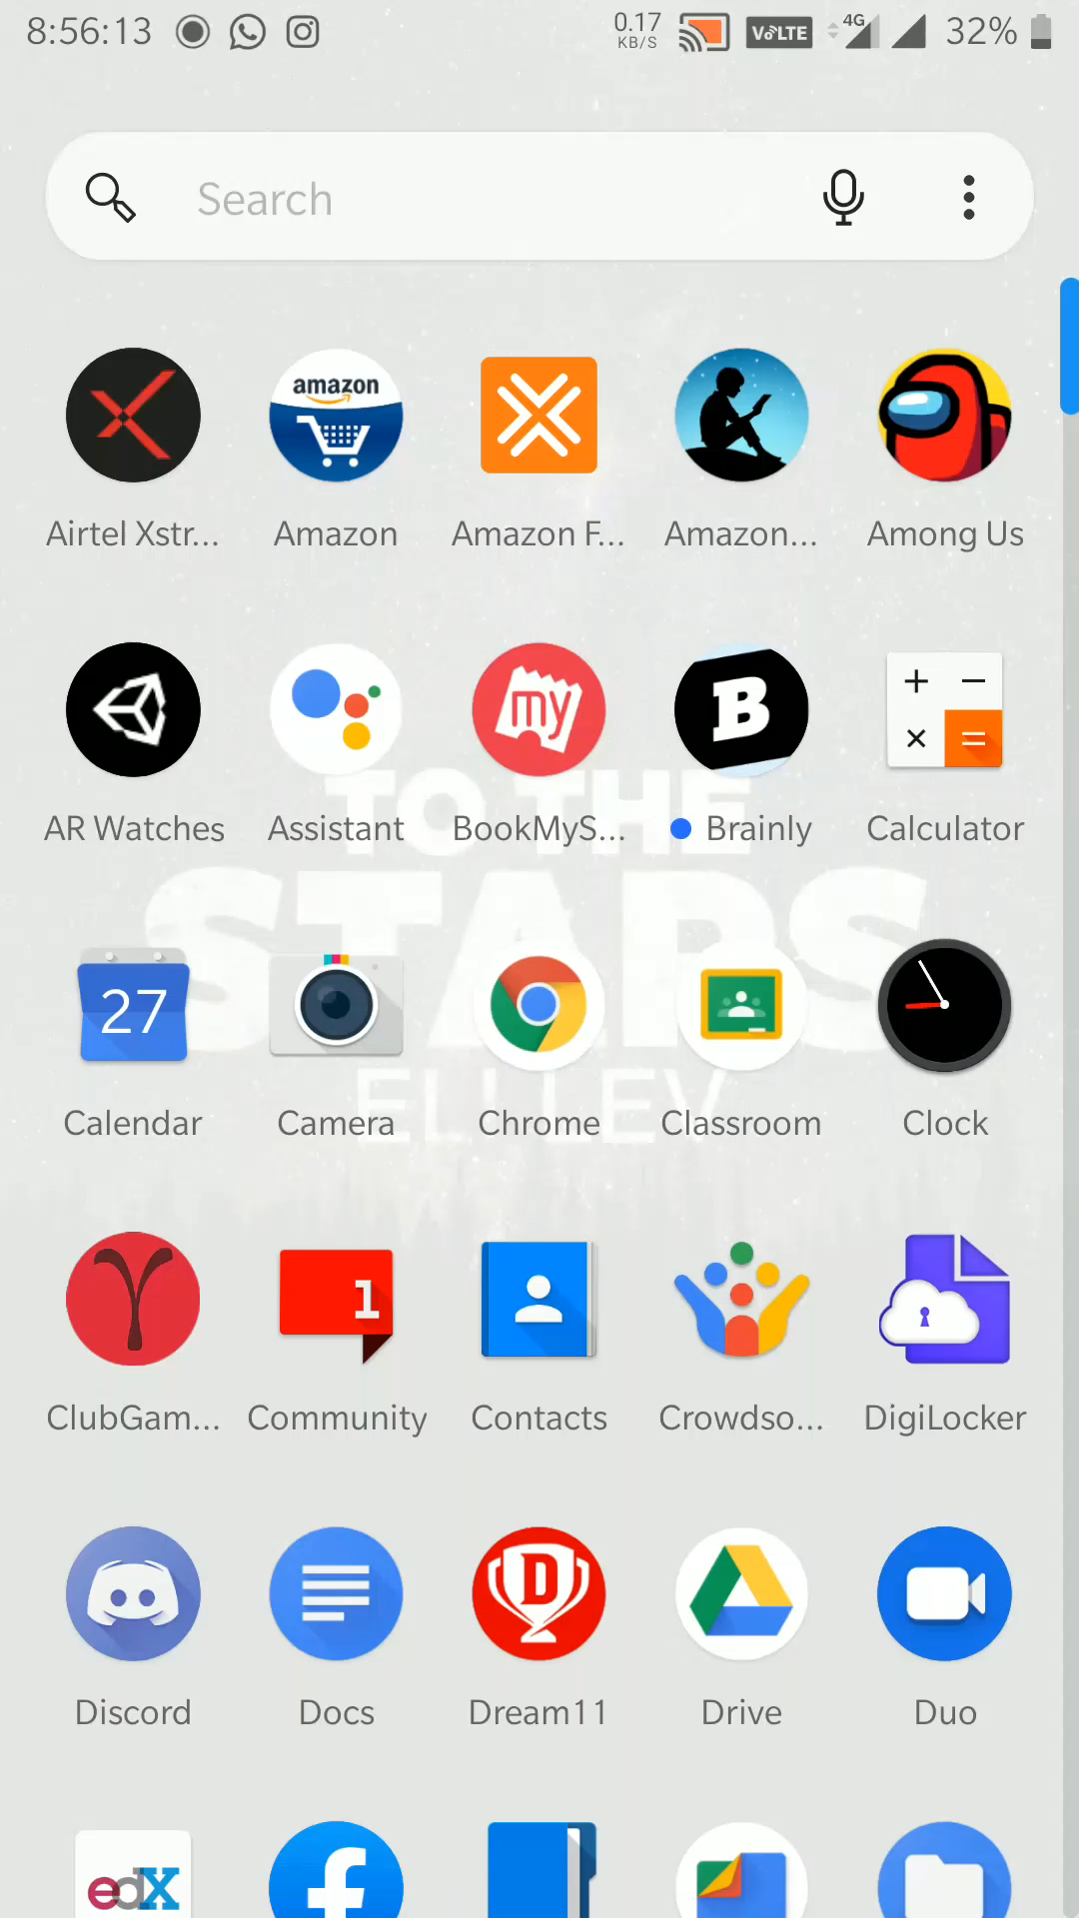
VIDEO DEMONSTRATION
Notes:
R

Slide 22
LIMITATIONS AND
FUTURE SCOPE
Size of hand may differ due to which customer may face problem while Virtually trying it
We can add buying feature for the products so that they don't need to go to any other platform for purchasing
Limited no. of models/designs are available
Notes:
A

Slide 23
Virtual Watch Catalogue
CONCLUSION
Enhancing the Business
Saving of Quality Time
Saving of Resources
Friendly interface
Easy to use
Notes:
A

Slide 24
REFERENCES
https://unity.com
https://readwrite.com/2019/03/28/why-you-should-use-augmented-reality-in-your-business-app/
https://www.udemy.com/course/augmented-reality-merge-cube-create-your-augmented-reality-application/
https://www.youtube.com/watch?v=MtiUx_szKbI
https://developer.vuforia.com/
https://unity3d.com/learning-c-sharp-in-unity-for-beginners

Slide 25
THANKYOU

